Slide 1



Secure Chat Application using Java
Presented by :
Mahek Mulla
Ameesh Mhatre
Dhiraj Kapse

Slide 2

CONTENTS
Introduction
Problem Statement
Literature Survey
Modules
Limitation and overcome
Proposal
Block diagram
ER diagram
Conclusion
References

Slide 3


Introduction
Our project is an example of Client Server Chat application
Our main objective is to overcome security threat while chatting.
We have used latest AES encryption technique.
After establishing connection users can be able to send encrypted text by default with provided features they can also send key or plain text to receiver.

Slide 4
Problem Statement
This project is to create a chat application with a server and client to enable chatting with each other. To develop an instant encrypted messaging solution & to be able to seamlessly communicate with each other in an secure way. It will convert a plain text into cipher text. The project should also be easy for a rookie person to use.

Slide 5
Literature Survey
A considerable research effort has been devoted to Chatting Application in the last few years. Many new researches have been proposed in recent times. The algorithm used for encrypting text messages was AES standard which is slower than other block cipher but it provides higher security.The emergence of computer network and telecommunication technologies bears the same objective that is to allow people to communicate. All this while, much efforts has been drawn towards consolidating the device into one and therefore indiscriminate the services.

Slide 6
MODULES
Server Module
A server is a software or hardware device that accepts and responds to requests made over a network. Server has higher authority and privilege.

Slide 7
Client Module
A client is any computer hardware or software device that requests access to a service provided by a server
Clients are typically seen as the requesting program or user in a client-server architecture and have less authority than server.

Slide 8
Limitations and Overcome
One major disadvantage of most instant chat application is their prone to security attacks
The reason is the fact that, messages which are sent over the network is in a plaintext format with no encryption and decryption protection, thereby enabling intruders with no privileges to gain authentication sequence and alter the message content and make modifications to the message stream, learn the traffic pattern and course denial of service

Slide 9

Overcome
To Overcome security attacks AES Algorithm is used for encryption
It takes 128 bits as input and outputs 128 bits of encrypted cipher text as output.
AES relies on substitution-permutation network principle which means it is performed using a series of linked operations which involves replacing and shuffling of the input data.

Slide 10
Proposal
The purpose of this project is to develop a Client-Server chat application where by instant messages are encrypted with a private key at the transmission end, and decrypted with the same private key at the receiving end on the network using the Advanced encryption standard algorithm (AES standard) .

Slide 11
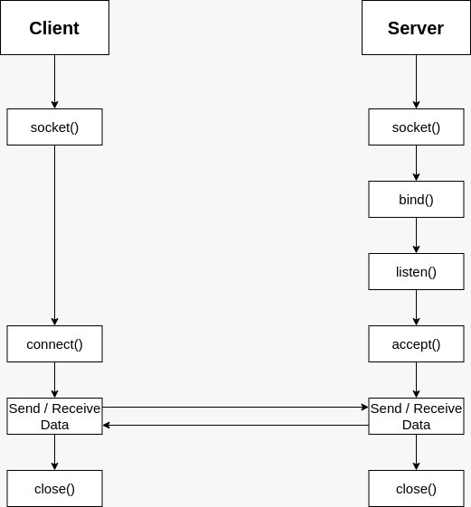
Block Diagram

Slide 12
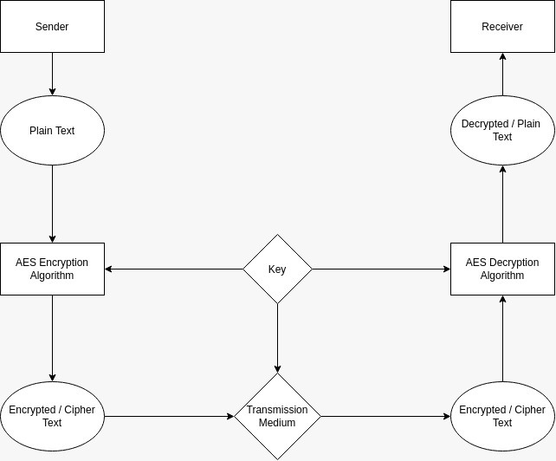
ER Diagram

Slide 13
Conclusion
As a result we are able develop a functional Encrypted Client-Server chat application with easy to use GUI and robust features.

Slide 14

References
https://www.w3schools.com/java/
https://www.tutorialspoint.com/cryptography/advanced_encryption_standard.htm
https://medium.com/nerd-for-tech/create-a-chat-app-with-java-sockets-8449fdaa933

Slide 15
Thank You

